Slide 1
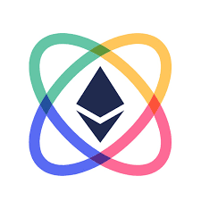


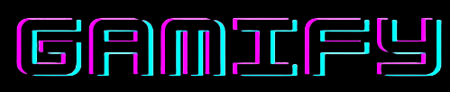
Team macBlockers
Presents

Slide 2
Enter the world of Web3 gaming, where ownership, control, and earning potential are no longer just in-game achievements but a reality for every player.
Gamify, a decentralized digital game distribution platform which offers a seamless experience for gamers to discover, purchase and play their favourite games.
The Gamify platform also integrates NFTs as tradeable in-game items and assets that can be minted which in turn can be used to trade, sell, stake their assets in the game community.

Slide 3
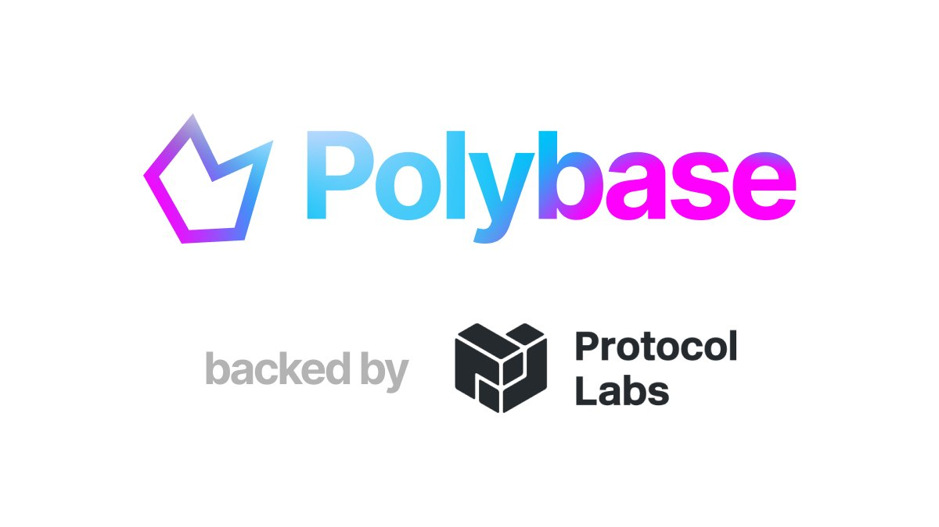
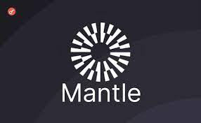


Technologies Used:
POLYBASE
MANTLE
SCROLL
PUSH PROTOCOL

Slide 4
The project uses Polybase for its database where it stores and renders all the images, text etc. related to the games on the platform.
This technology helps replace the centralized databases by providing enhanced security, privacy, and transparency.

Slide 5
The NFTs are minted using a contract deployed on MANTLE. These NFTs are specific for a game.
They are available in different rarities and act as in game items or collectibles. (“common”, “rare”, “super Rare”).
Once a game is bought by the user, they can obtain new collectibles by minting NFTs using the MANTLE contract.

Slide 6
The most important aspect of the project is purchasing games. This is done by leveraging a contract deployed on SCROLL’s Zk-EVM.
This contract runs on L-2 and hence can help when the project needs to be scaled, i.e when more users are onboarded.

Slide 7

The platform provides a space for discussion that helps build a sense of community, provide support and increase player engagement and retention.
This uses the PUSH chat, where each user can join the specific game community which is a PUSH group to discuss, trade and invite each other to play together in any game.
The project also implements PUSH notifications to help notify the user when a new NFT is minted and to also show the transactions to confirm their ownership.

Slide 8
THANK YOU!
Team Members:
Nischith T N
Jayavibhav N K
Nikhil Ravi
P Malvika Reddy

